Slide 1
Determining the Business Information Systems Strategy
MSSI 2018F

Slide 2
Structure
Corporate & business strategy and IS/IT implications
Aligning
IS/IT with business strategy
Managing the app. portfolio
Organizing the strategic managmnt of IS/IT
A strategic perspective of IS/IT
Business innovation with IS/IT
Determine the IS strategy
Key ideas & the future of IS/IT strategy
Establish IS/IT strategy process
Search for competitive opportunit. to shape strategy
Justifying & managing IS/IT investments
The strat. Managmnt of IT service & infrstructure
Establishing strategic management framework
IS/IT strategy: tools & techniques
Portfolio & investment management
Organizing, sourcing, and infrastructure management

Slide 3
Session Objectives
Understand how to effectively use the tools and techniques in IS/IT strategy formulation

Slide 4
Agenda
Business Strategy and IS/IT
Tools for IS/IT Strategy Formulation and Their Relationships
A Framework for Using the Tools and Techniques Effectively
Identifying How IS/IT Could Impact the Business Strategy
Establishing the Relative Priorities for IS/IT Investments
Large Organizations, Multiple SBUs and Strategy Consolidation

Slide 5
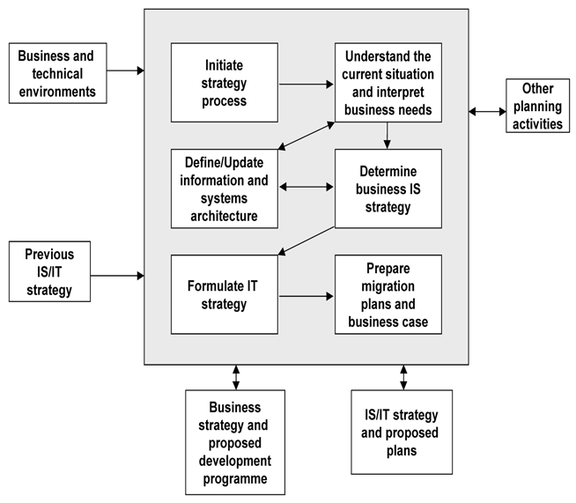
IS/IT Strategy Formulation & Planning Process: The Framework

Slide 6
IT-enabled Business Transformation
Key findings of 2010 study of IT-enabled business transformations in major European corporations by the Business Transformation Academy:
Those transformations that were integral of the future business strategy were all at least partially succesful.
Conversely those that had primarily ‘reductionist’ intention (e.g., restructuring to reduce costs) were less successful.
Interestingly and perhaps counter-intuitively, in most of the successful programmes the need to change was ‘high’ – clearly recognized as a business priority – but initially the readiness to change was ‘low’.
The more successful transformations were based on clear, explicit strategic drivers plus strong financial business cases.
Those with weaker strategic drivers but good financial cases gained less commitment and were usually less successful.
‘Strategic’ transformations cannot be fully planned in advance and have to adapt to both changing business conditions and achievements to date.

Slide 7
IT-enabled Business Transformation
Some organizations thought they may have ‘overplanned’ things at the start … However, the planning activities were seens as essential to bring stakeholders together and for reconciling their different priorities and interests.
Having a clear vision of the intended future business and organizational models and how IS/IT enables them is more likely to achieve stakeholder commitment than imposition.
The successful transformations usually addressed the organizational, people and capability aspects first, before dealing with the process and technology aspects.
Most ‘strategic’ transformations require the development or acquisition of new business and/or IS/IT capabilities and knowledge in order to be carried out successfully.
Most transformations involve at least two distinct and different phases – first to create capability and second to exploit it. In most of the cases the new capability was created but not always used effectively.
While creating a new capability can be done ‘off-line’, separately from business-as-usual, using and exploiting it often competes with other operational priorities or can have negative effects on other aspects of operational performance, …

Slide 8
Business Strategy and IS/IT
Seeking alignment between business and IS/IT strategies is essentially about interpreting the business strategy in terms of both the IS demand and IT supply strategies
Exploring impact
Questions | Tools & Techniques | Implication for IS Strategy
Where to compete? | 5-Forces analysis PESTEL analysis | Explore how IS/IT can affect industry Identify economic, social, … technology trends
How to gain advantage? | PUV analysis, Business Model, Value Proposition analysis Customer & Product Portfolio life-cycle analysis Industry Value Chain Internal Value Chain Strategic Competences – operational excellence, customer intimacy, product/service leadership | Look for opportunities to informate products/services Explore how information can refine business model Explore how information supports/affects life-cycle Examine industry information flows for opportunities to share information for disintermediation/new intermediaries Identify how IS/IT can help outperform competitors in one or more dimensions

Slide 9
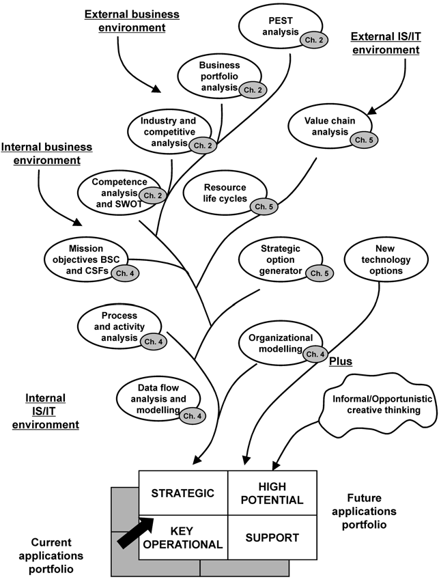
Tools for IS/IT Strategy Formulation and Their Relationships Objective: To Consolidate the Tools & Techniques as Strategic Management Approach to Adapt to Changes
Product & customer
lifecycle analysis
Business model &
Value proposition
Ch. 2

Slide 10
Tools for IS/IT Strategy Formulation and Their Relationships
Factors influencing the balance of application potfolio:
External long-term – economic & business environment:
Industry profitability, growth, competitive dynamics, regulation, structure
How IS/IT is capable of changing the products/services (by informating them), markets and business relationships (via new intermediation) of the industry
External short-term – the IS/IT environment:
Actual use of IS/IT by competitors to gain advantage
IS/IT-based opportunities to change balance of competitive forces
Internal long-term – business & organizational environment:
How new apps could more effectively support business strategy or enable a new strategy to be followed
How new apps could enable business model to be changed to improve operational performance or the customer value proposition
Internal short-term – IS/IT capability & current application portfolio:
How well existing apps support current strategy and either prevent business disadvantages and/or sustain existing advantages
The IS/IT resources and competences the organization has/can acquire and the relationship between IS/IT and business management

Slide 11
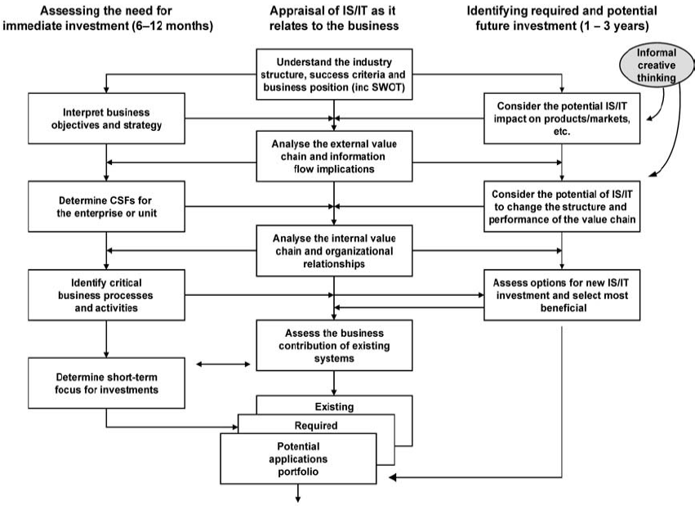
Framework for Using the Tools & Techniques Effectively
Innovation Management Processes
and determine CSFs
Assess current
Capabilities – strategic assets and competencies
Identify options for new
IS/IT investments and select most beneficial
Identify medium &
Long-term
Investment priorities

Slide 12
Framework: 3 Types of AP as End-product
The main objective of determining the IS strategy is to identify the required applications and their priorities, and be able to deploy resources to achieve them successfully. The application portfolio is divided into 3 components:
The existing applications —those currently in place and being developed to be installed in the near future, usually 6–12 months. They should be assessed in terms of their contribution to existing business processes and performance and how well they support the achievement of known future requirements. The strengths and weaknesses of each need to be understood, be in a future as well as a current context.
The required applications —those that will be necessary to achieve the business objectives and strategy within the business planning horizon and can be shown to have specific contributions to make.
The potential applications —those that might prove valuable in the future, provided they prove feasible to deliver and can be shown to produce relevant benefits, either to the strategy directly or by significant indirect effects through improved business performance.

Slide 13
Framework: the 3 Paths of Analysis
central column: the need to continually reappraise how both the external and internal environments are changing and the role that IS/IT is or should be fulfilling in the business and its relationships
left-hand column: the need to make decisions on how best to deploy available business and IS/IT resources in the immediate future
right-hand column: the need to identify and monitor new or emerging IS/IT-based opportunities to create potential advantages for the organization (or that might result in disadvantages if ignored)

Slide 14
Identifying How IS/IT Could Impact The Strategy
1
Innovation Management Processes
2,3
4
5
and determine CSFs
7
6
Assess current
Capabilities – strategic assets and competencies
Identify options for new
IS/IT investments and select most beneficial
Identify medium &
Long-term
Investment priorities
Notes:
E.g., Airways in adopting On-line ticketing system:
Business position: early-adopter or follower
On-line ticketing will broaden market (reach more customers and more direct)
Business objective needs to focus on customer
Since there will be no/less Travel Agens, how can flight info be distributed to customers? What about payments?
Determine the CSFs
Does it still need Travel Agents? If it does, what values would they be providing? What is needed to make sure the chain provides better value to customers? To Airways?

Slide 15
Identifying How IS/IT Could Impact The Strategy – Steps
Understanding the industry, competitive forces, and potential IS/IT impact
Competitive position and the forces affecting performance and development for each business unit should be understood, so that any IS/IT options can be focused on responding/creating strategic options that will increase the likelihood of future success.
Interpreting business objectives and strategy
We need to bring together the potential impacts of IS/IT on the industry and the objectives of the organization either to revise objectives, develop new ones, or adjust the ranking of existing objectives based on the importance of IS/IT threats and opportunities.
Determining CSFs
Assessing the potential IS/IT impact on products/services
Identification of ways in which IS/IT could impact the industry in terms of products/services/economics and be used to affect the relative strengths of the competitive forces
Analyzing the industry (external) VC and the information implications
Analysis of industry VC can lead to refinement of business objectives and a more focused evaluation of the potential opportunities.
Understanding how IS/IT could change the industry VC & firm’s value propositions
Refinements of VC analysis using Customer/Product Life-Cycle analysis and/or Strategic Option Generators enable consideration of what others might also do to improve their competitive positions. This may help the firm decide whether and how it could extend its IS further into the VC in order to influence or even prevent changes others might make …
Assessing current capabilities – strategic assets and competences

Slide 16
Identifying How IS/IT Could Impact The Strategy – Deliverable
The overall outputs are effectively a view of the IS/IT-enabled opportunities and threats affecting the firm’s future, based on its relationship to the business environment and its overall strategy.
The view identifies current and future demands and suggestions for IS/IT investments, which could either influence the firm’s strategic options or enable successful execution of its strategy.
No consideration has been made of its ability to deal with them, to take advantage or avoid being disadvantaged.

Slide 17
Establishing The Relative Priorities For IS/IT Investments
Innovation Management Processes
and determine CSFs
Assess current
Capabilities – strategic assets and competencies
1
2
3
Identify options for new
IS/IT investments and select most beneficial
4
4
Identify medium &
Long-term
Investment priorities
Notes:
Need to strengthen the Outbound Logistic, Marketing, and Service Chains as customers will be dealt directly (without intermediaries: TAs)
What are the critical business processes now?
…
…

Slide 18
Establishing The Relative Priorities For IS/IT Investments – Steps
Analyze the internal VC, business model, and organization relationships
Although opportunities for gaining advantage from IS/IT exist in both primary and support activities, problems leading to disadvantages are more obvious and severe in the primary activities. This reinforces the need to establish a clearly understood view of the strengths and weaknesses of existing applications in the context of the primary activities in terms of how they impact business operations and relationships with trading partners.
Identify critical business processes and activities and implications for the business operating model
The nature of the potential for business improvement will vary depending on the relationship between the value adding, cost and the CSFs associated with activities and processes. The information & app requirements derived from the analysis can now be categorized into those that are critical to current business success, those that are likely to affect future success, and those that merely support the business processes (key operational, strategic, support)
Identifying and assessing new options for investments
The ideas and options need to be considered in terms of:
Whether and how they could provide the organization with specific advantages or reduce foreseeable threats, and
whether and how, in the shorter term, they can contribute to the existing business strategy by improving the current operational and developmental processes.
Determine the future application portfolio: short, medium, and long-term business IS demand
It is worth emphasizing that it is perhaps more important to deal with serious weaknesses first, especially if they could soon result in a real threat to the business or are precluding opportunities being taken. E.g., will not integrating key operational information make a futher strategic application impossible?

Slide 19
Establishing The Relative Priorities For IS/IT Investments – Deliverable
Future Applications Portfolio
Note: Most multi-business-unit organizations will have some scope to benefit from examining not just one business unit but also looking across business units, before deciding on how best to meet information and system requirements.
whether the units are in similar competitive positions in their industries, whether the industries have similar rates of growth (or decline) and whether the types and mix of competitors are different;
whether they have similar levels of strategic competency in each of the three key dimensions—customer, operations and product;
whether they carry out similar processes (i.e. are the internal value chains of the same type and/or are some or all of the primary value chain components similar?);

Slide 20
exercises

Slide 21
Exercise #1: Blue Bird Taxi
Alignment
Objective: increase profit
CSFs
Process Analysis: payment transactions
Impact
Where to compete
5-Forces analysis: new entrants
PESTEL analysis
How to gain advantage
PUV analysis, BM, VP analysis
CRLC analysis
Industry VC
Internal VC
Strategic Competences – OE, CI, SL

Slide 22
Exercise #1: Blue Bird Taxi
Understanding the industry, competitive forces, and potential IS/IT impact
Presence of UBER, GO-JEK, GRAB …
Role of APPs …
Interpreting business objectives and strategy
How to stay in ‘taxi’ business?
Determining CSFs
Compete to retain customers
Assessing the potential IS/IT impact on products/services
How could APPs informating the ‘taxi’ business?
Analyzing the industry (external) VC and the information implications
Customer-taxi contact – origin-destination – payment
Understanding how IS/IT could change the industry VC & firm’s value propositions
Location-dependent (customer – taxi) vs. Location-independent; Pricing …; Additional services: tracking …
Assessing current capabilities – strategic assets and competences
Do we have capabilities to build better APP?

Slide 23
Exercise #1: Blue Bird Taxi
Analyze the internal VC, business model, and organization relationships
…
Identify critical business processes and activities and implications for the business operating model
…
Identifying and assessing new options for investments
Can we keep-up with UBER/GO-JEK/GRAB/New-Entrant?
Should we cooperate with them?
Determine the future application portfolio: short, medium, and long-term business IS demand
…

Slide 24
Exercise #2: Hummel
Rina Hansen & Sia Siew Kien, 2015. Hummel’s Digital Transformation: Toward Omnichannel Retailing. MIS Quarterly Executive, Vol. 14, No. 2.

Slide 25
End of Presentation

